Slide 1
Practical Layouts in HTML + CSS
Mike Blatter

Slide 2
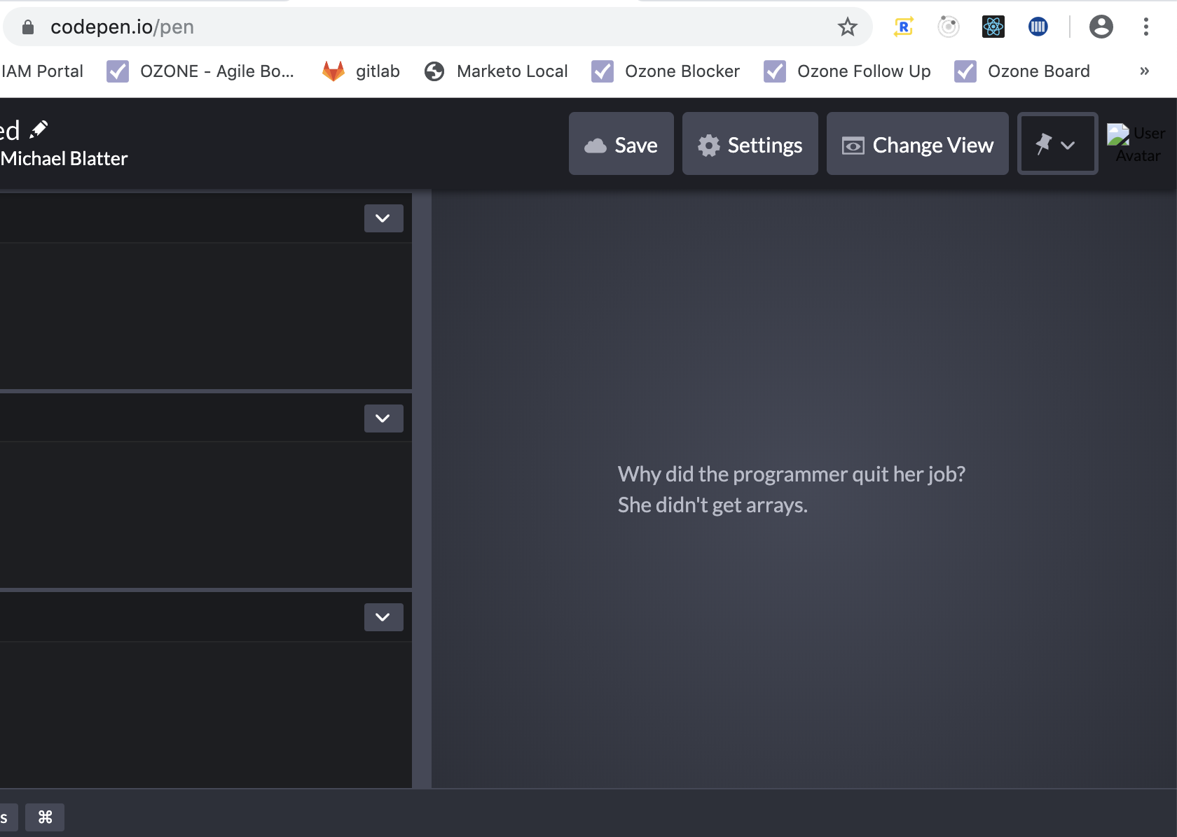
Demo In CodePen
First PowerPoint Overview
Then will present examples in CodePen
Included CodePen links in git, will share

Slide 3
Legacy Layouts
Tables
Floats
Positioning
All incomplete solutions to laying out an interface

Slide 4
Modern Web Layout Systems
Flexbox
1 dimensional layout system
Items can flex their sizes
Grid
2 dimensional layout system
Layout First – Top Down Approach
Content First – Bottom Up Approach
Adapting layouts to available space

Slide 5
Flexbox
aims to provide a more efficient way of layout, alignment, and distribution of space among items in a container, even when unknown; hence flex
single direction
row (default) or column
simple parent -> child relationship in HTML
parent is flex container
children are the flex items
declare the flex container with: display: flex;

Slide 6
Flexbox 1-Dimension Layout Model
main axis/dimension
primary axis sizing
main start/end
flex items are placed from main-start to main-end
flex item
hypothetical container used for grouping + alignment, laid out between flex lines
cross axis/dimension
perpendicular to main
cross start/end
flex lines are place from cross start to end

Slide 7
Flexbox: Flexibility on Items
One of the defining aspects of flex layout is the ability to make items “flex”
Define on children of a flex container
flex: initial
inflexible when is leftover space, but can shrink to its min when there is not enough space
flex: none
inflexible
flex: auto
fully flexible, not default
flex: <positive number>
flexible and flex basis to 0. results in an item getting the proportion of free space
flex basis is initial main size of item before distributing space
if all items use this then their sizes will be proportional to the specified flex factor

Slide 8
CSS Grid
2-dimensional grid-layout system
CSS Grid excels at dividing pages into sections or defining the correlation in terms of size, position, and layer
same as flex, whole module, simple parent child HTML relationship
declare the grid container with: display: grid;
sizing of rows and columns are determined by the grid-template-rows grid-template-columns CSS properties

Slide 9
CSS Grid Sizing
Sizing is controlled in two dimensions
grid-template-columns (x) + grid-template-rows (y)
Sizing can be done using lengths (px, %), min-content, max-content, auto
repeat() allows you to specify number of columns or auto-fill/auto-fit and the widths so you don’t have to specify for each column
repeat(10, 100px) = 10 columns, 100 pixels
can also include auto-fit and auto-fill in repeat() instead of specifying number of columns

Slide 10
Grid: The FR Unit
Fractional Unit
Nominal unit that represents a fraction of leftover space in a container
We can also mix in other measurements like pixels or percentages
The free space is calculated after any non-flexible items
1fr 1fr
50/50
1fr 1fr 1fr
33/33/33
50px 1fr 1fr
(free space – 50px) then 50/50

Slide 11
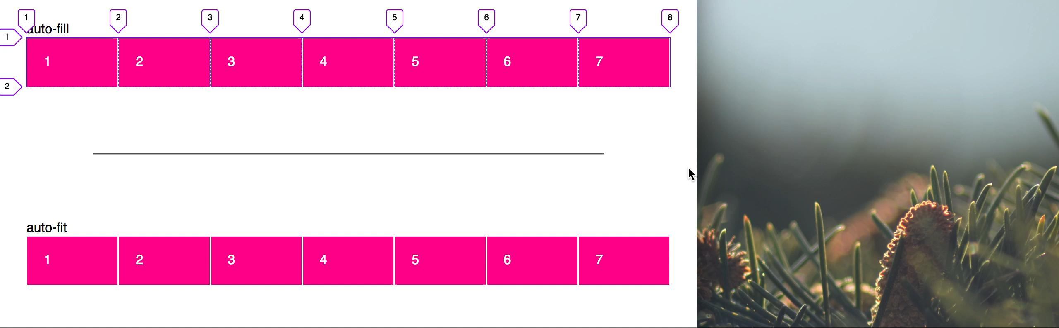
auto-fill vs auto-fit
CSS Grid auto-fill and auto-fit allow us to achieve responsiveness and wrapping when a viewport becomes to small
auto-fill
FILLS the row with as many columns as it can fit
auto-fit
FITS the CURRENTLY AVAILABLE columns into the space by expanding them so that they take up any available space

Slide 12
Grid + Flex Together
You can combine these two layout modules together
Flex can be used within Grid
Important: Grid cannot be used within Flex

Slide 13
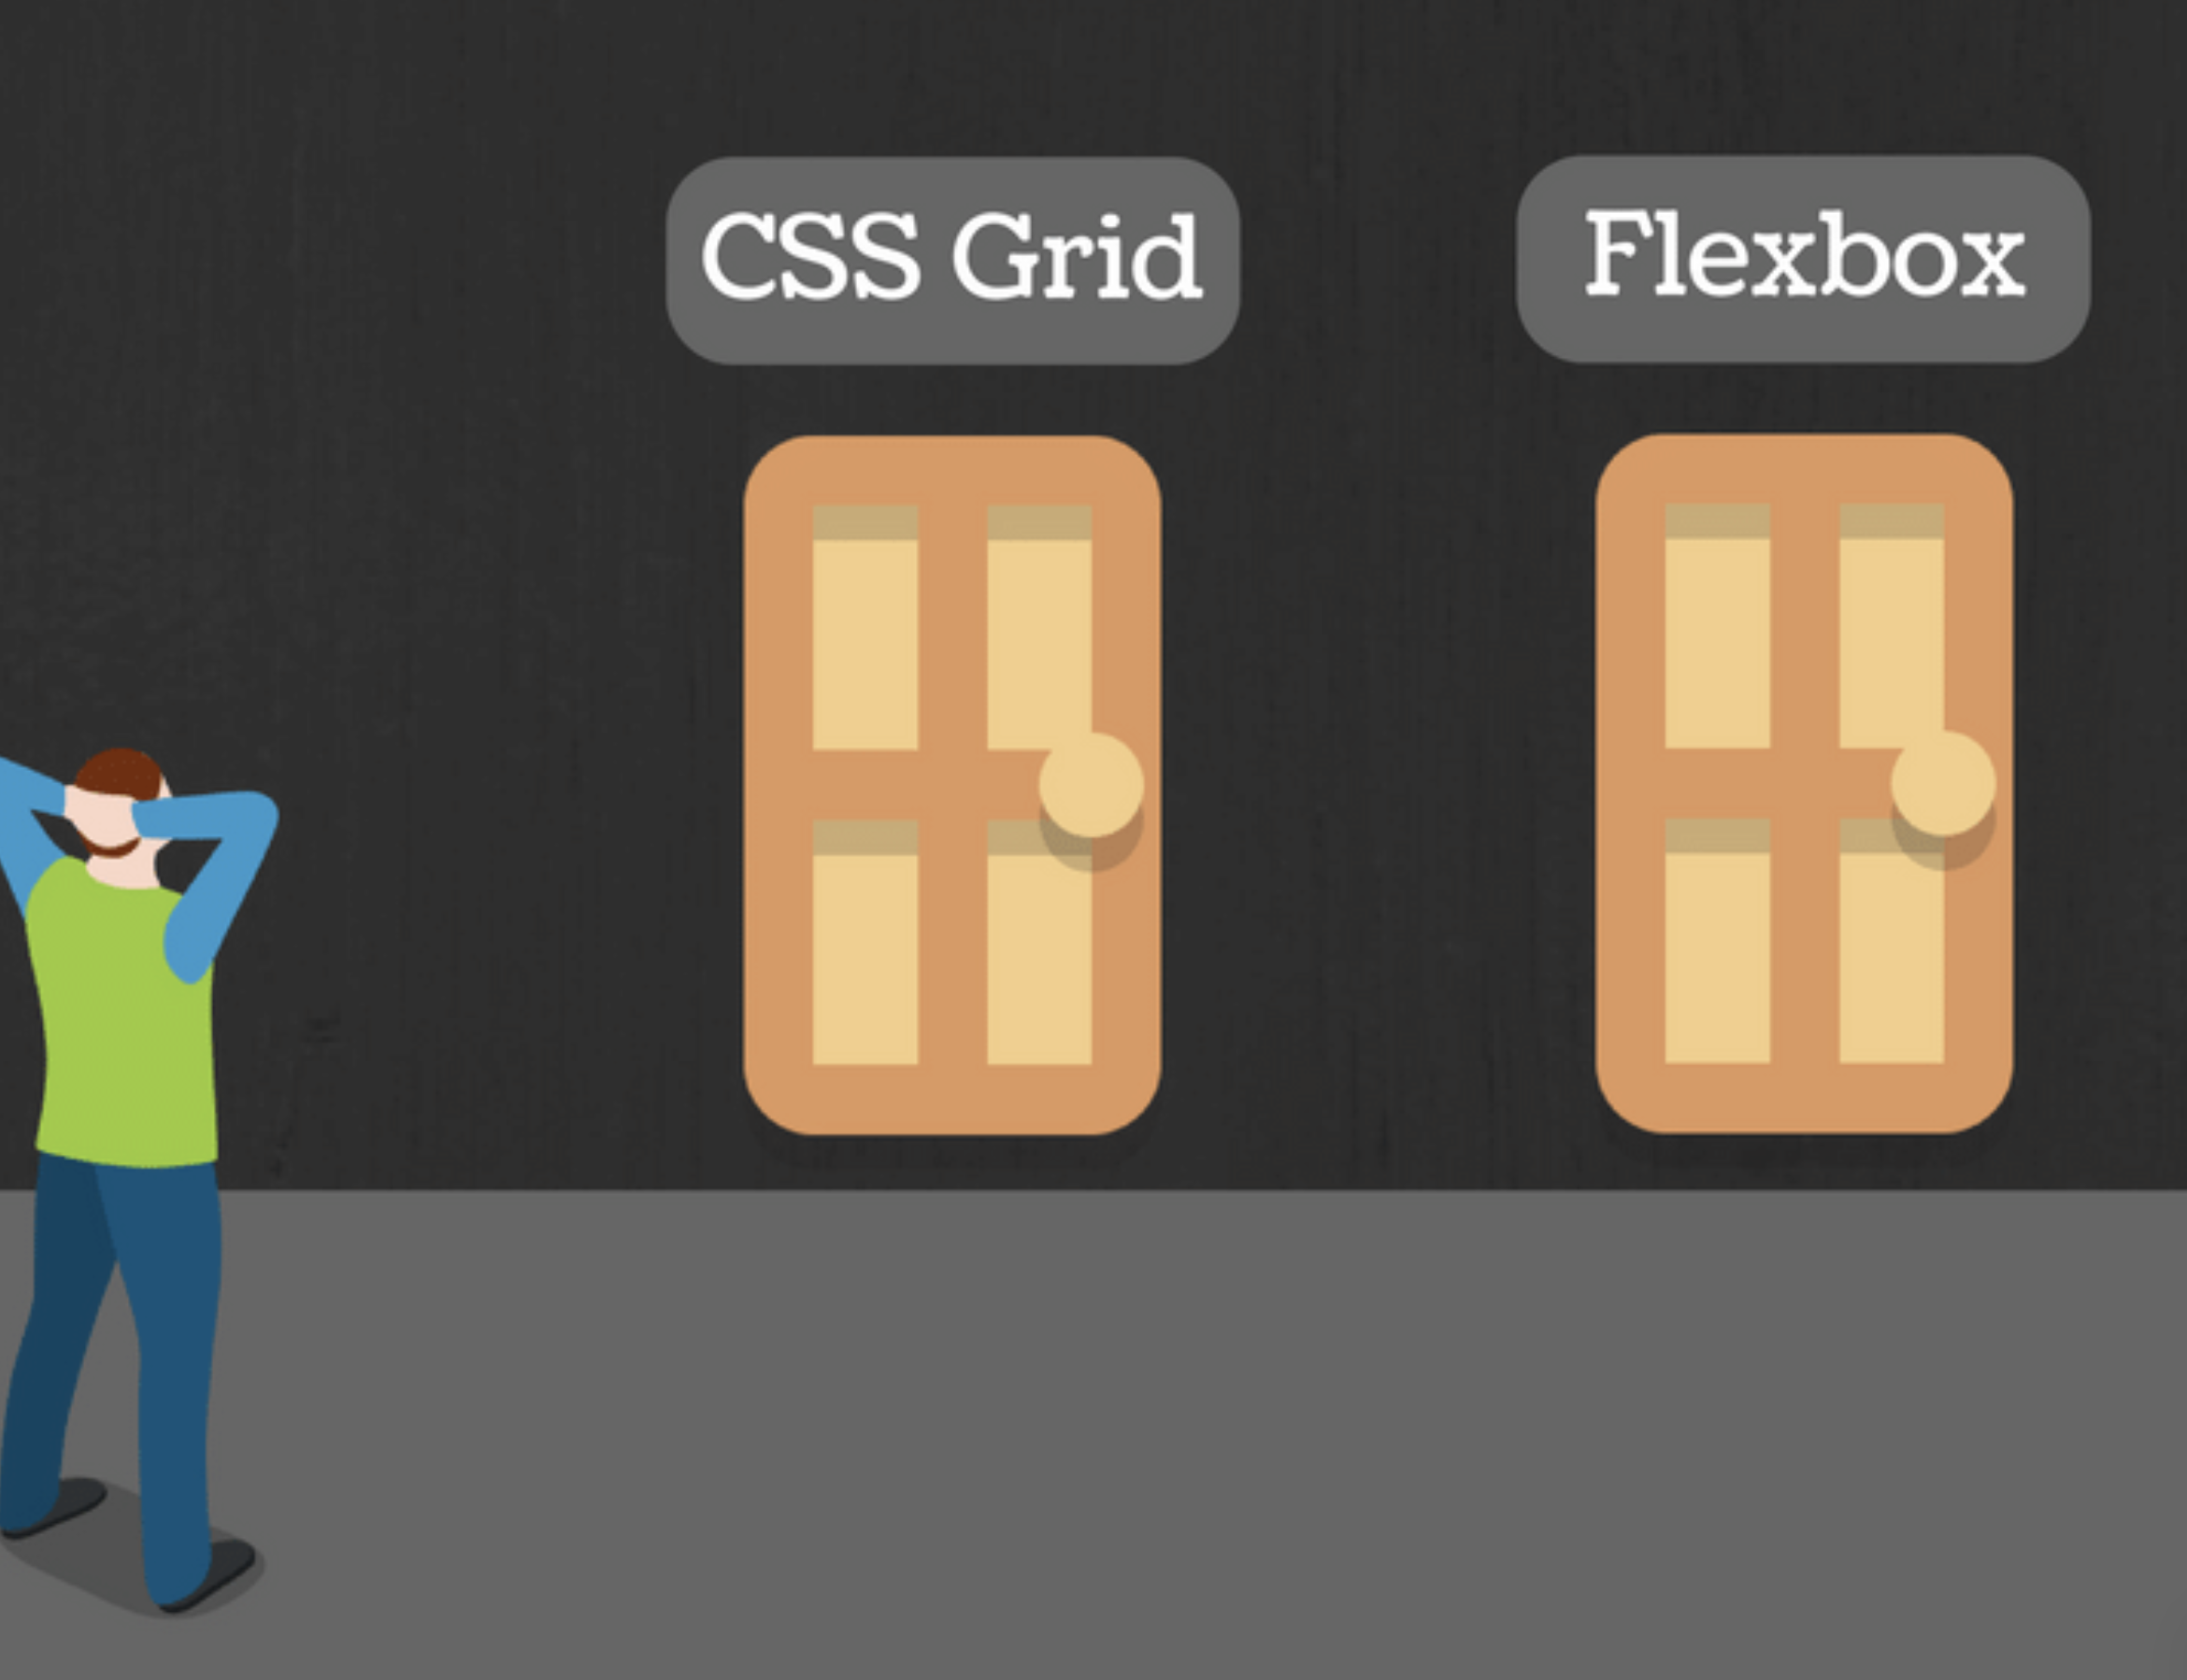
Flex or Grid?
Is this component one or two-dimensional?
If you can take your component and draw a grid over it, with rows and columns. It is two-dimensional — use grid layout for that.
If instead, you want individual items to expand within a row, without respecting what happens in the row above. That’s a flex layout.
Grid is layout first, flex is content first
Grid has a top down approach, bottom up for Flex

Slide 14
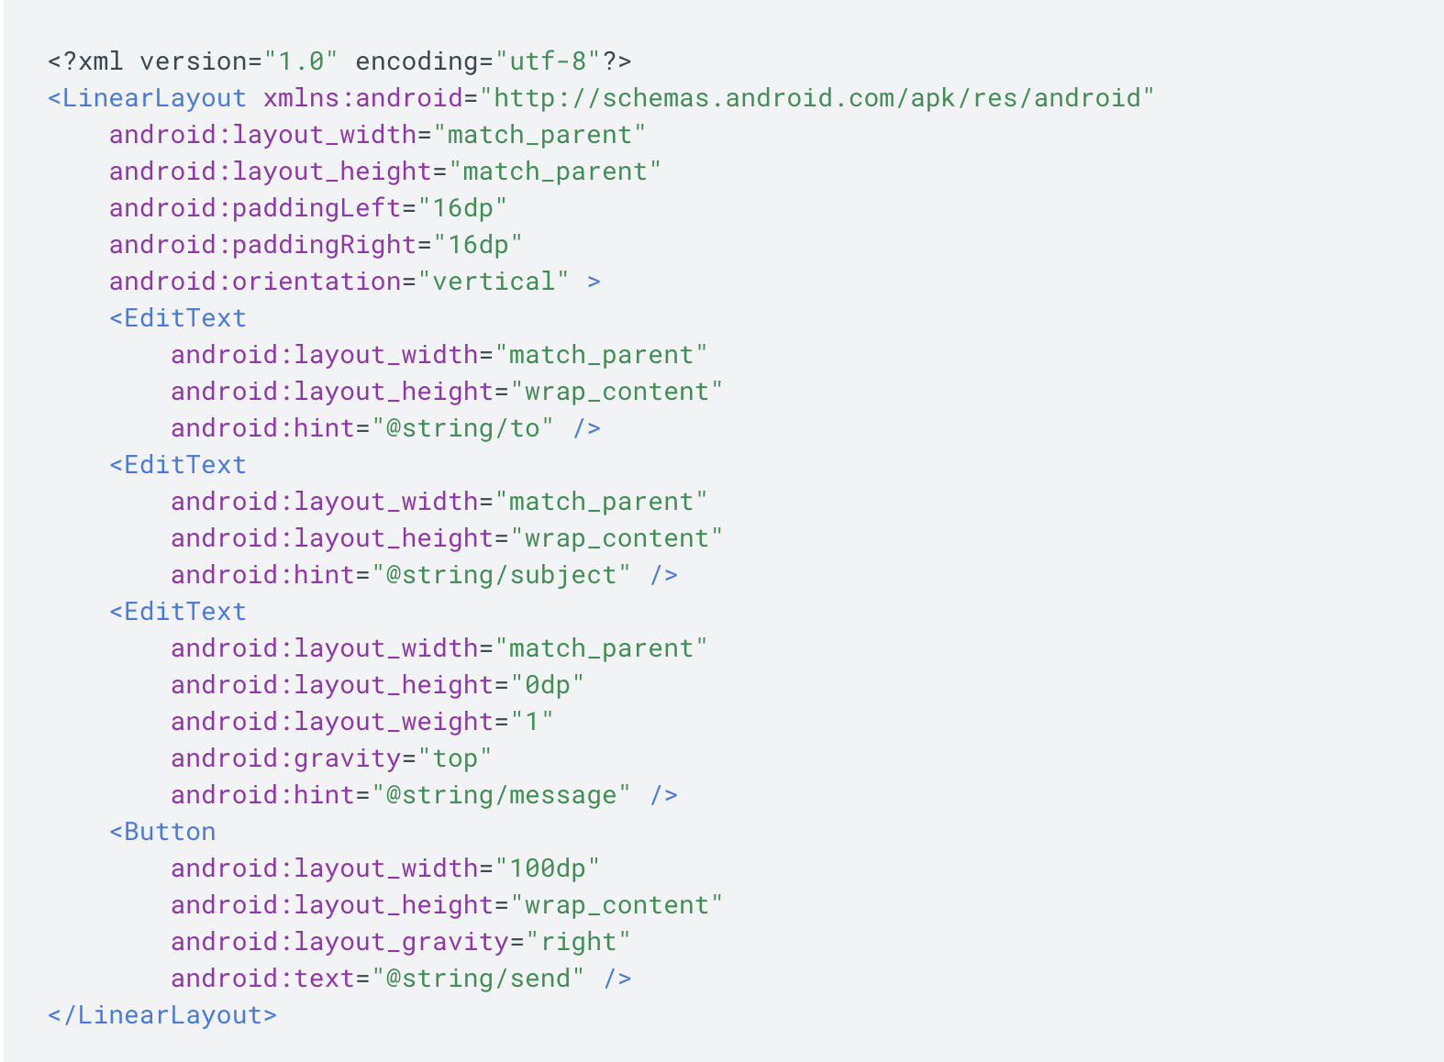
Mobile’s Version of Layouts
Android
LinearLayout
left to right
up and down
RelativeLayout
absolute
relative
iOS
StackView
samesis, left to right
up + down
Storyboard + Constraints
Drag/Place objects on storyboard in IDE UI
Add constraints to set them in a given spot

Slide 15
Sources
https://www.w3.org/TR/2018/CR-css-flexbox-1-20181119/
https://www.w3.org/TR/css3-grid-layout/
https://medium.com/youstart-labs/beginners-guide-to-choose-between-css-grid-and-flexbox-783005dd2412
https://css-tricks.com/snippets/css/complete-guide-grid/
https://css-tricks.com/snippets/css/a-guide-to-flexbox/
https://flexboxfroggy.com/
https://gridbyexample.com/
https://scotch.io/tutorials/a-visual-guide-to-css3-flexbox-properties
https://css-tricks.com/auto-sizing-columns-css-grid-auto-fill-vs-auto-fit/

